Slide 2
Meet the Gears Behind Kubernetes APIs:
Introduction to SIG API-Machinery
Federico Bongiovanni - @fedebongio
Engineering Manager at Google - Co-Chair of SIG API-Machinery

Slide 3
Introduction to SIG API-Machinery
Agenda
Introduction & SIG Overview
What do we own?
What do we not own?
Why it's so central and important (and hard)?
What did we do for you lately?
Roadmap / Working Groups
Recurrent Meetings & How to get involved

Slide 4
SIG Overview
Kubernetes Cluster
User Node
User Node
User Node
User Node
Master Node
User Node
Master Node
User Node
Master Node
User Node
User Node
User Node
etcd
etcd
etcd
What runs in the master nodes is usually called the Kubernetes Cluster Control Plane

Slide 5

SIG Overview
Is API Machinery == Kubernetes APIs?
No….
But it does own a few individual APIs, which turn to use the same machinery as the rest of the other individual APIs.

Slide 6
SIG Overview
API Machinery != Kubernetes APIs
SIG API Machinery is responsible for the development and enhancement of Kubernetes cluster control plane. The scope covers API server, persistence layer (etcd), controller manager, cloud controller manager, CustomResourceDefinition and webhooks. (SIG Charter)
API Machinery = the machinery ("technical stack") used by the different Kubernetes APIs to be exposed and actuated, and the mechanisms to publish, process and extend them.

Slide 7
What do we own?
Kubernetes Cluster Control Plane
Kubernetes Cluster
User Node
User Node
User Node
User Node
Master Node
User Node
Let's zoom here
Master Node
User Node
Master Node
User Node
User Node
User Node
etcd
etcd
etcd

Slide 8
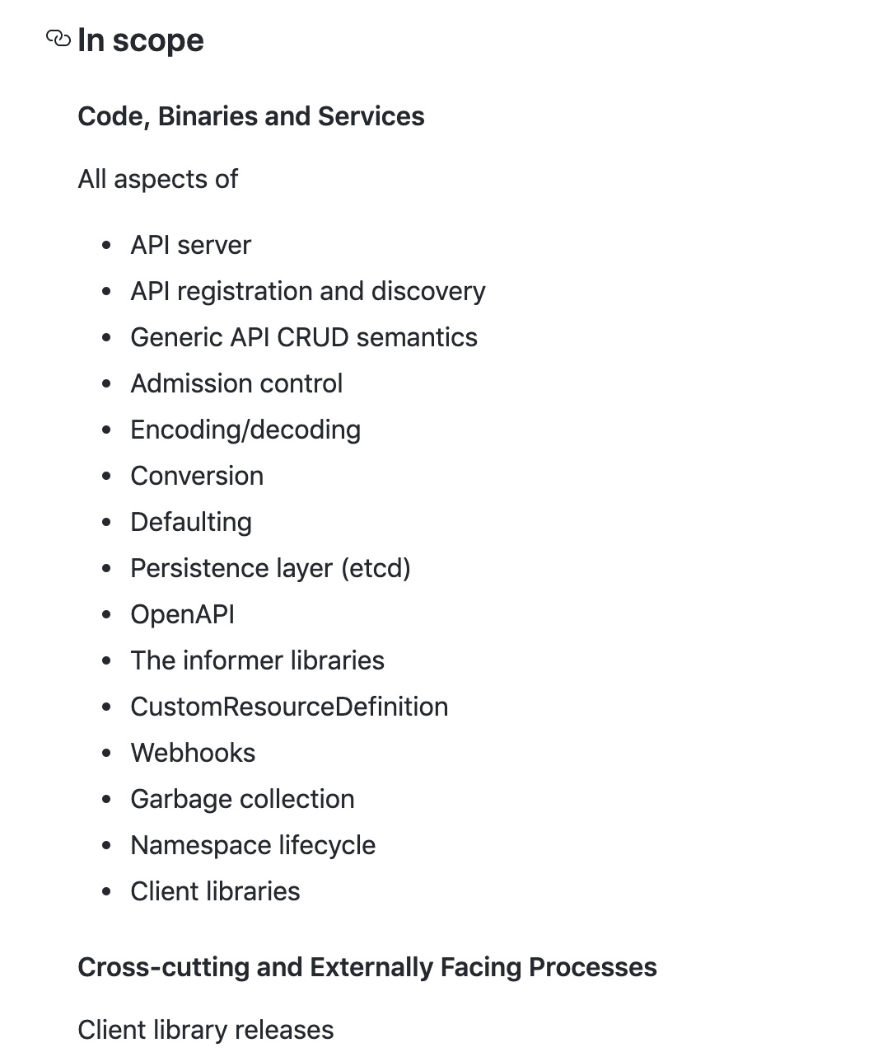
What do we own?
The formal and precise list of components can be found in our charter:
In other words...
kube-apiserver
...and generic apiserver library
storage path (to etcd)
Controller framework and some concrete controllers like
Garbage Collector
Namespace
Client generators (and client-go)
Serialization stack
Object conversion and defaulting mechanisms

Slide 9
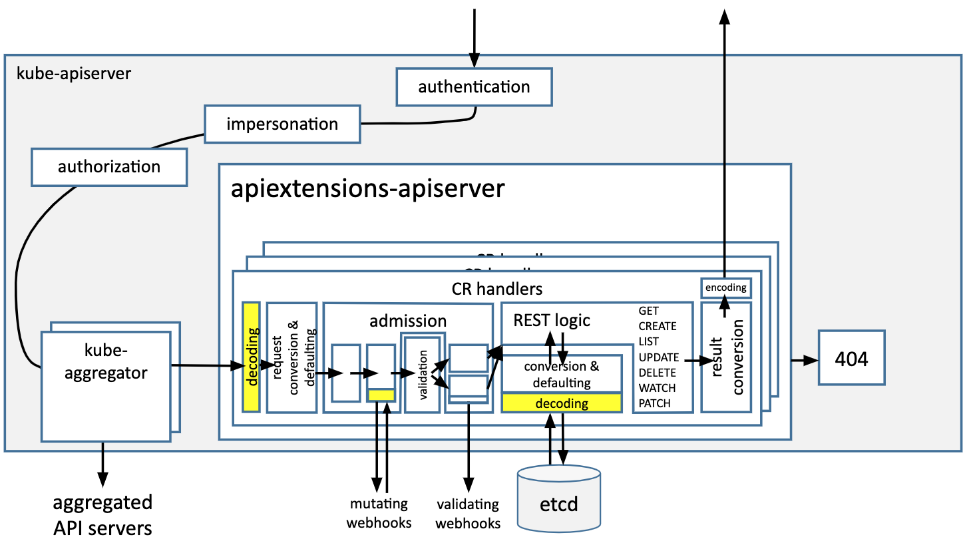
What do we own?

Slide 10


Did you know?
...about 25% of the Kubernetes code base (!) belongs to API Machinery?

Slide 11

What do we not own?
Easy! The other 75% of the k8s/k8s code, and everything built on top of our APIs and extension mechanisms!

Slide 12
What do we not own?
API Machinery = the generic machinery ("technical stack") used by the different Kubernetes APIs to be exposed and actuated, and the mechanisms to publish, process and extend them.
So with that said, we are not the owners of:
All the individual Kubernetes APIs (each API is owned by it's own SIG or WG)
We don’t own most controllers (each Controller has a concrete owner which is not us)
We usually don’t own the operational characteristics of your cluster (support questions)
We don’t own your particular API review :)
...unless you’re trying to set up a pattern for everyone.
“downward facing” extension mechanisms and frameworks

Slide 13






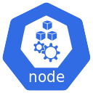
Why it's so central and important (and hard)?
Kubernetes Cluster
Master
Extensions

Slide 14
Why it's so central and important (and hard)?
Kubernetes Cluster
Master
Extensions

Slide 15
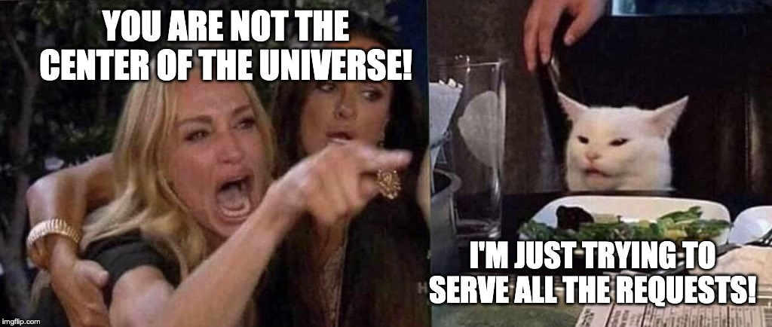
Why it's so central and important (and hard)?

Slide 16
What did we do for you lately?
"Extensibility" to GA/Stable in 1.16
CRD promoted to GA in 1.16
Admission Webhooks promoted to GA in 1.16
"Defaulting" promoted to to Beta - only available in v1
Server-side apply maturity - yay for beta
Please try it and provide feedback
(related) Storage Migrator to Beta
(related) Network Proxy to Alpha
(related) Better and more stable metrics for the future
(related) helped build, release and upgrade to etcd 3.4
Contributed to increase ~11% addition of conformance tests

Slide 17
Roadmap
API server proxy support / SSH Tunnels deprecation
Trying for beta in 1.18 - see KEP
Server-side apply
Looking for feedback for another beta
Multi-stage beta discussions - see discussion.
Priority and fairness for API requests
Trying to land as alpha in master this 1.17 release.
API PR 83671
Start of library helpers PR 83665
CRD work continues
Immutable fields
Binary transport format being investigated - no fixed date
Storage Migrator to GA
28 Open KEPs tagging API Machinery

Slide 18
Meetings and Working Groups
Regular SIG meetings:
SIG Meeting: every 2 weeks
PR and Bug triage: twice every week (Tue - Thu)
Regular Working Group meetings:
Working Group Apply: every 2 weeks
Working Group Kubebuilder and SDK: monthly meeting

Slide 19
Introduction to SIG API-Machinery
Chairs/Leads
@deads2k (Co-Chair and Tech Lead)
@lavalamp (Tech Lead and emeritus Co-Chair)
@fedebongio (Co-Chair)
Useful links
Home page: https://github.com/kubernetes/community/tree/master/sig-api-machinery
SIG Charter: https://github.com/kubernetes/community/blob/master/sig-api-machinery/charter.md
Slack channel: https://kubernetes.slack.com/messages/sig-api-machinery
Youtube Playlist: https://www.youtube.com/playlist?list=PL69nYSiGNLP21oW3hbLyjjj4XhrwKxH2R
Mail Group: https://groups.google.com/forum/#!forum/kubernetes-sig-api-machinery

